Slide 1
Recognizing Medicare Opioid Prescriber Patterns to Provide Initial Indicator of Potential Abuse
Randy Grant (DSML)
Notes:
Metropolitan Transportation Authority

Slide 2
Introduction
Issue: The client, AcmeMedicareScripts, needs a way to able to identify any trends in opiate prescriptions with existing Medicare Part D prescriber data
Solution: With sample data created from the 2019 Medicare Part D prescriber population data prescriber information:
trends without a machine learning model can be visualized
data can be added to the existing dataset
Goal: Recognize trends of how opioids are prescribed, a deviation from the median could be identified that will assist in preventing potential overdoses or abuse across Medicare patients

Slide 3
Methods
Data Used
Kaggle.com sample datasets
Medicare Part D Prescribers - by Provider and Drug
State Abbreviations
Tools Used:
Excel for data exploration
Tableau Prep Builder for data transformations
Tableau Public for visualizations
Metrics Created:
﻿Sample of Medicare Part D Prescribers: Opioid Prescription Volume Percentage Comparison Across the U.S. for 2019 with Death Percentage Comparison
﻿Sample of Medicare Part D Prescribers: Opioid Prescription Count By Drug Name and Specialty for 2019
﻿Sample of Medicare Part D Prescribers: Geographic Spread of Specific Opioid Prescriptions by State and Medical Specialty for 2019
﻿Sample of Medicare Part D Prescribers: Top Opioid Prescribers Split by Drug Name for 2019

Slide 4
Data Dictionary
NPI – unique National Provider Identifier number
Gender - (M/F)
State - U.S. State by abbreviation
Credentials - set of initials indicative of medical degree
Specialty - description of type of medicinal practice
Total number of prescriptions written for the year by the NPI by Drug name
Opioid.Prescriber - boolean value (0 or 1) indicating whether or not that NPI prescribed opiate drugs more than 10 times in the year
Reference: https://www.kaggle.com/datasets/apryor6/us-opiate-prescriptions

Slide 5
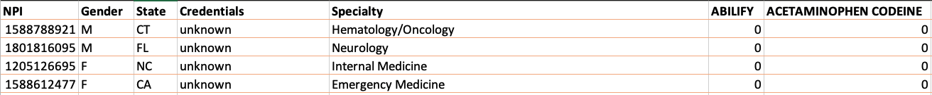
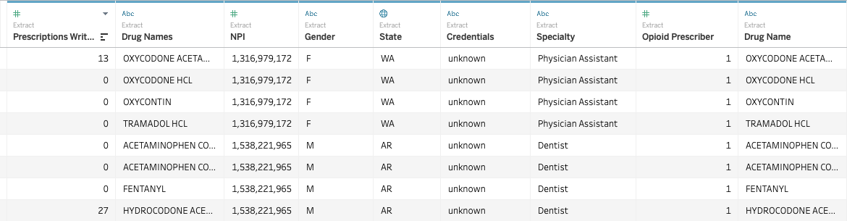
Sample Data
Raw (Excel):
Final Snippet (Tableau):

Slide 6
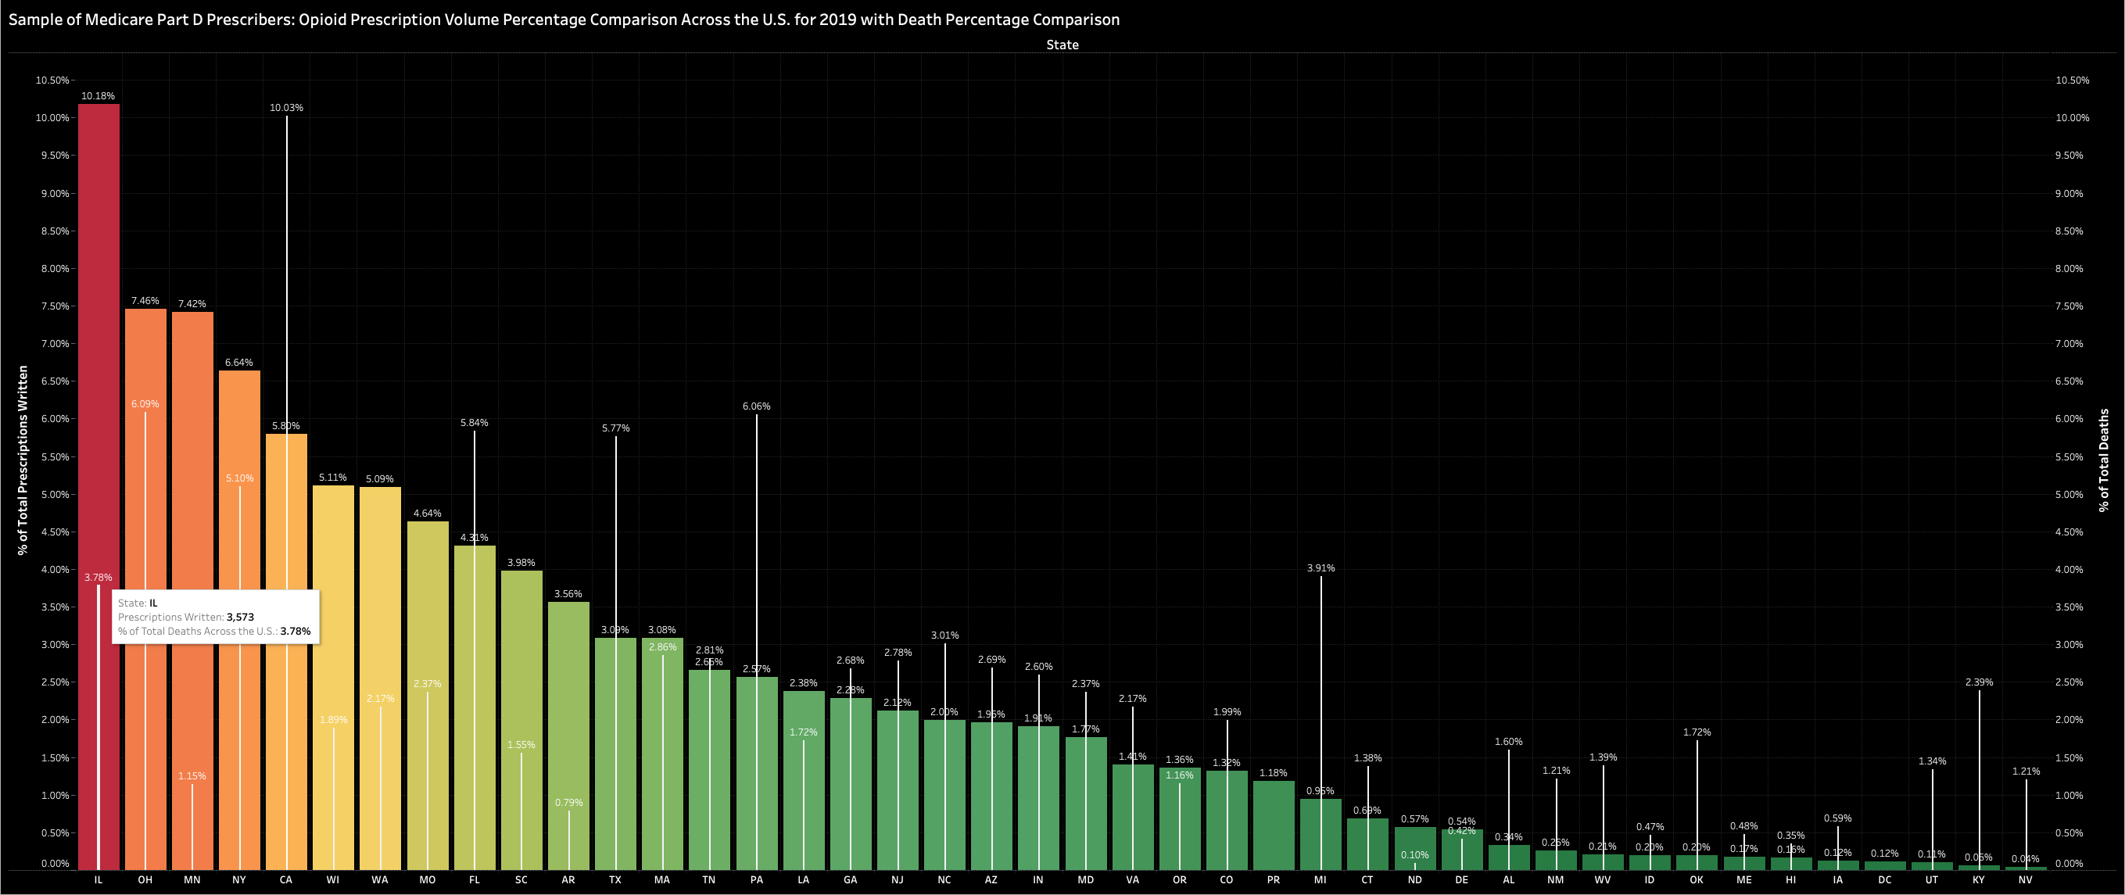
Metrics
Tableau Public Link

Slide 7
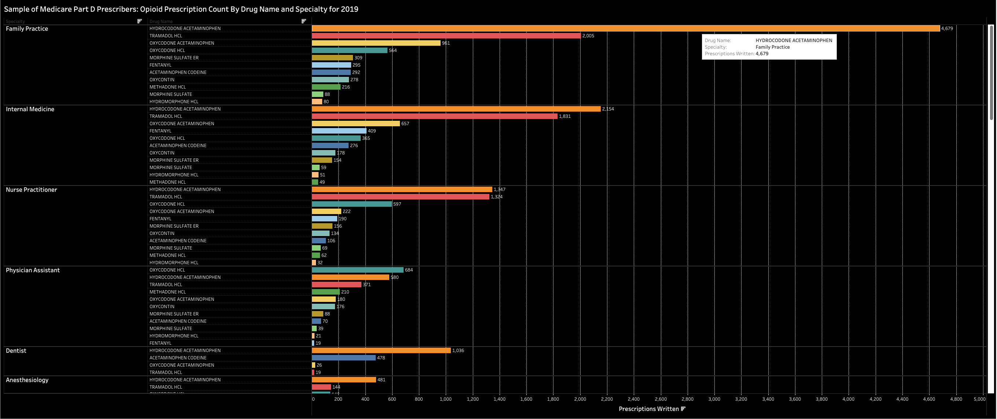
Metrics
Tableau Public Link

Slide 8
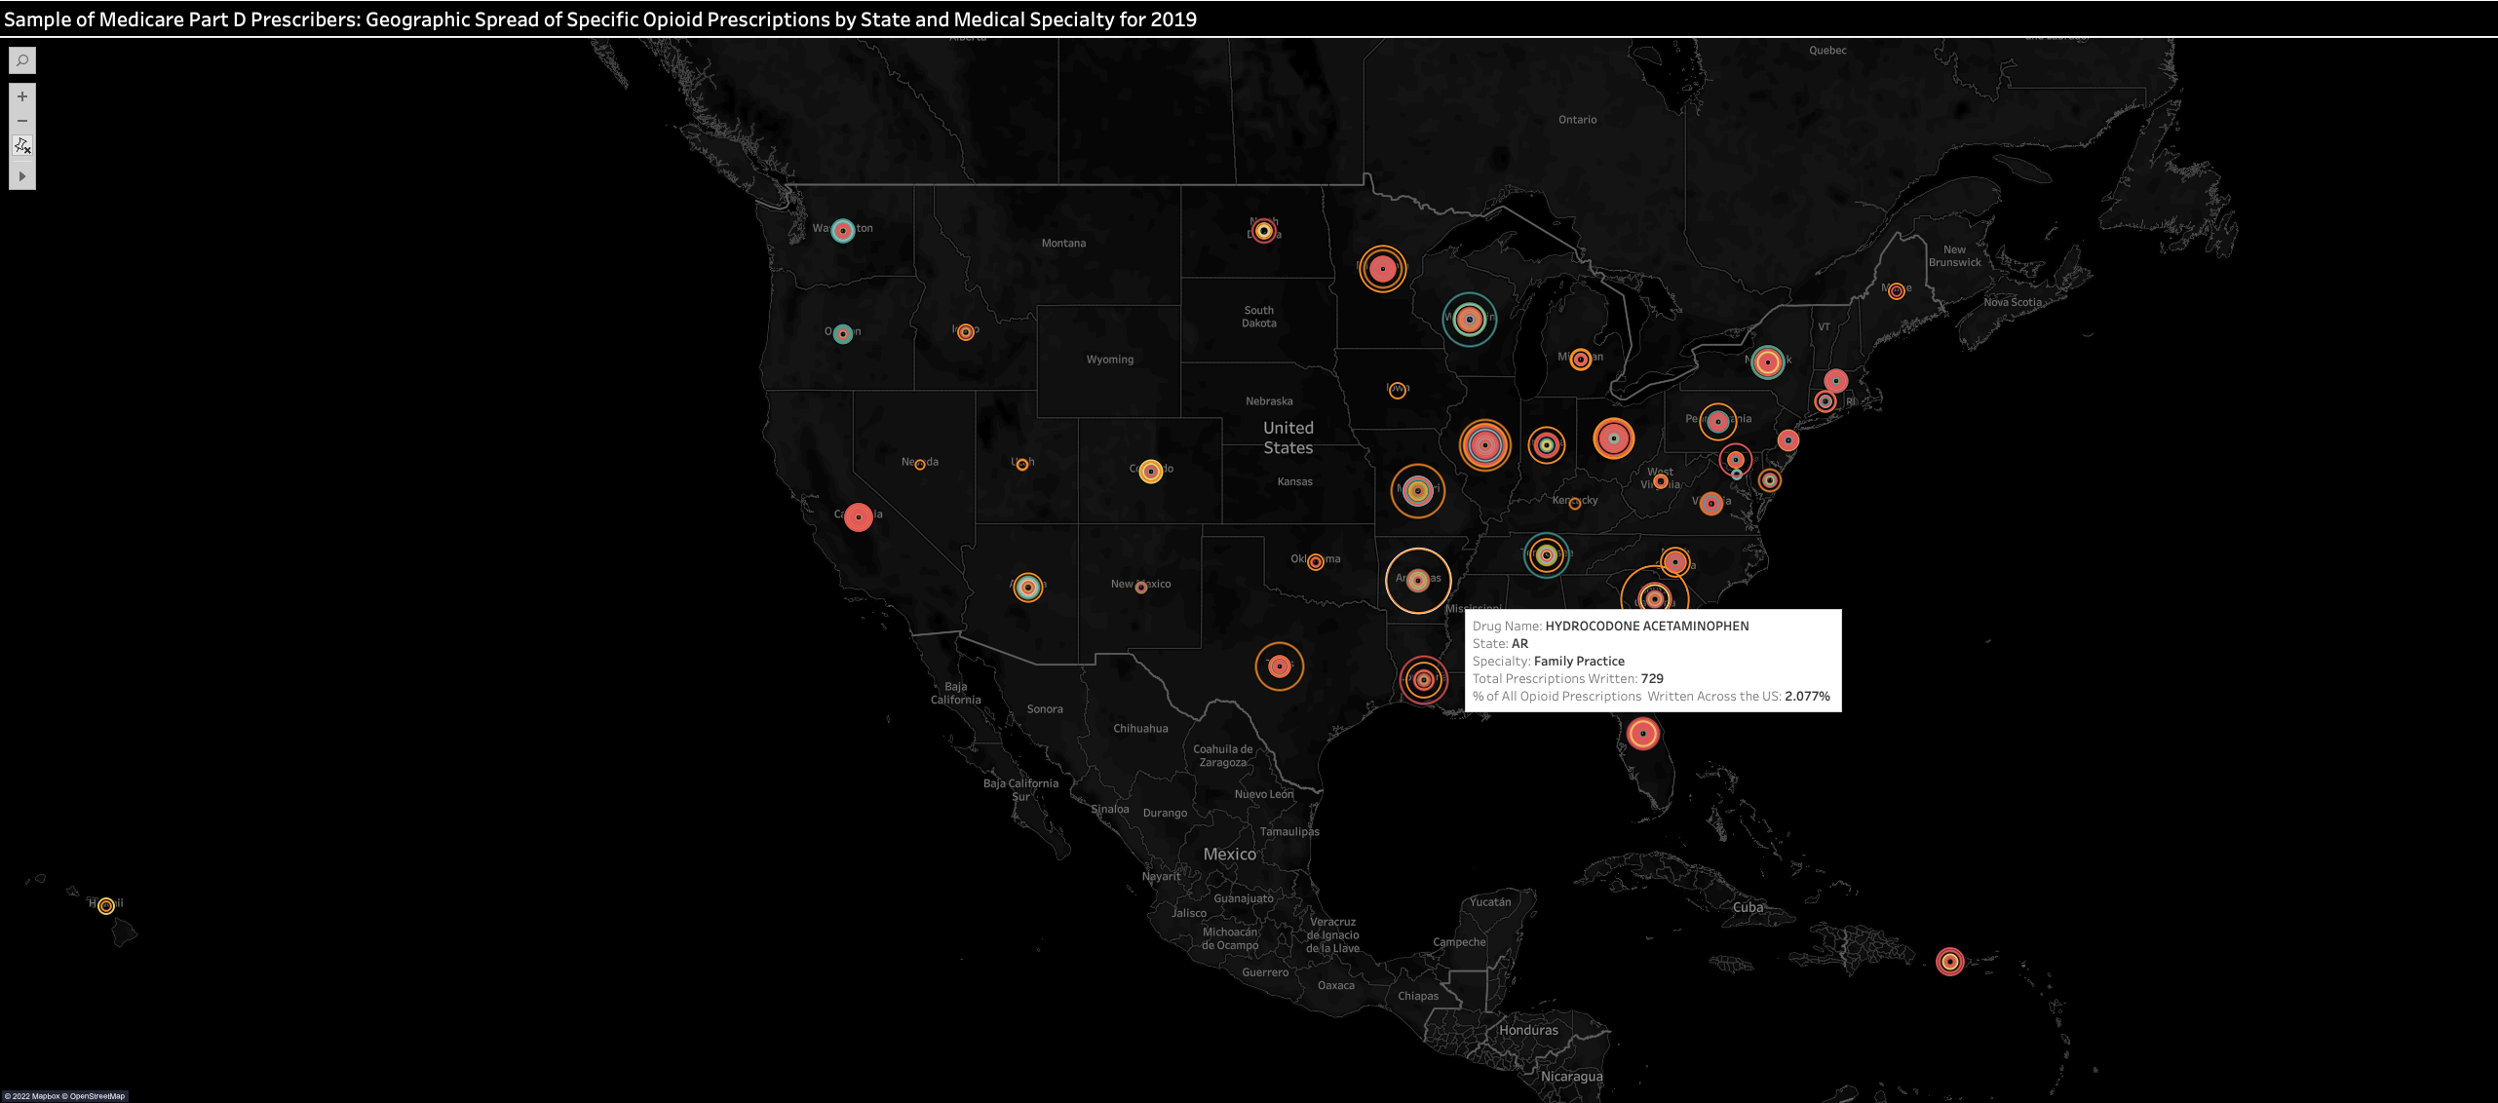
Metrics
Tableau Public Link

Slide 9
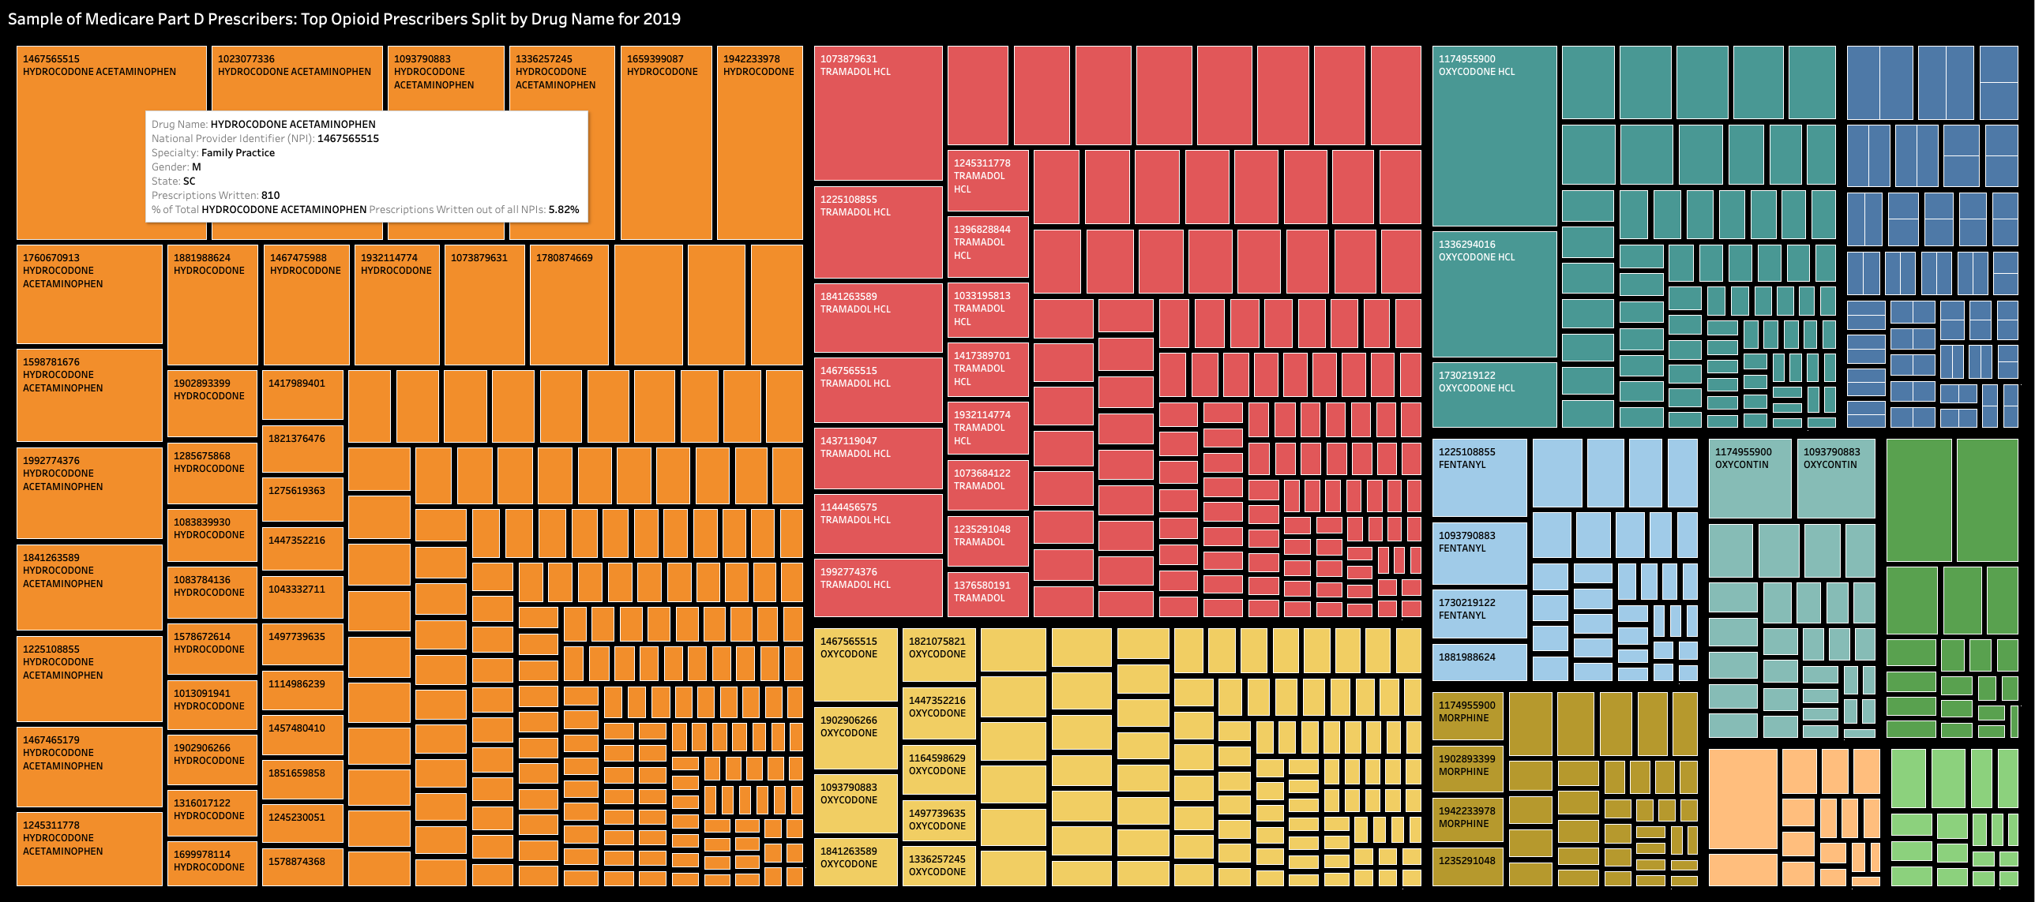
Metrics
Tableau Public Link

Slide 10
Appendix
https://www.cms.gov/Research-Statistics-Data-and-Systems/Statistics-Trends-and-Reports/Medicare-Provider-Charge-Data/Part-D-Prescriber
https://data.cms.gov/provider-summary-by-type-of-service/medicare-part-d-prescribers/medicare-part-d-prescribers-by-provider-and-drug
https://data.cms.gov/resources/medicare-part-d-prescribers-methodology
https://www.kaggle.com/datasets/apryor6/us-opiate-prescriptions
https://www.infoplease.com/us/postal-information/state-abbreviations-and-state-postal-codes

Slide 11

Thank you!
Questions?

